Slide 1



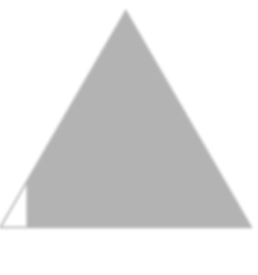



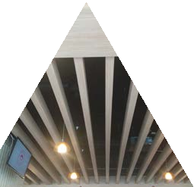

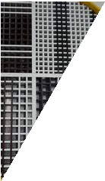
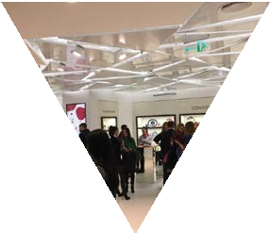
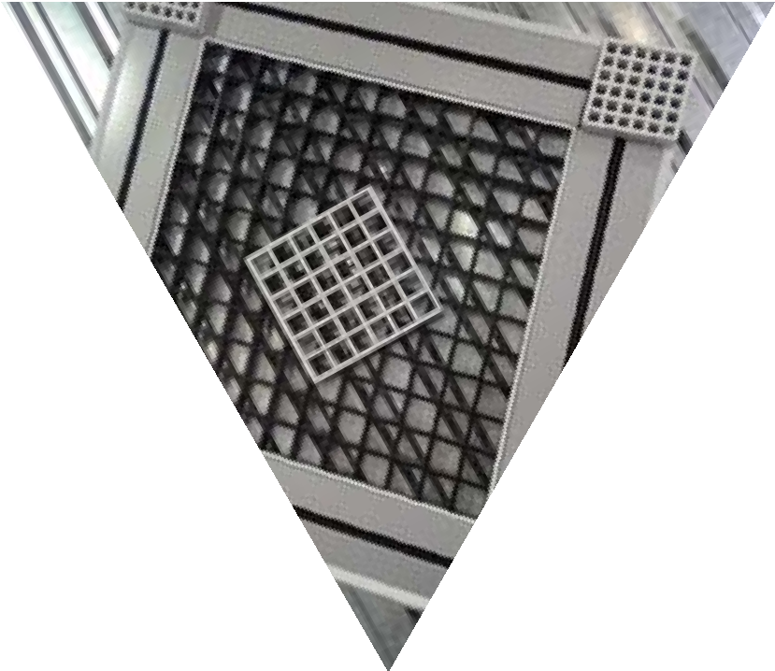
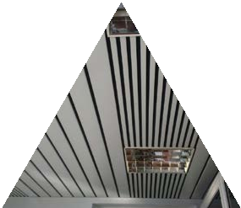

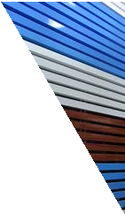







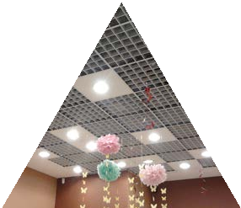
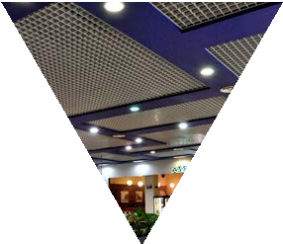
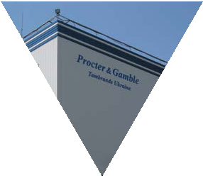
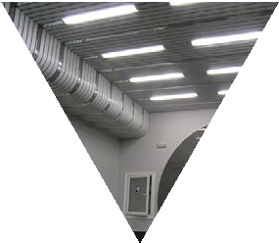
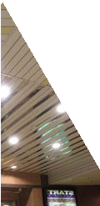
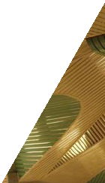
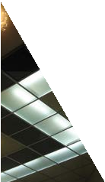




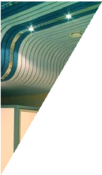
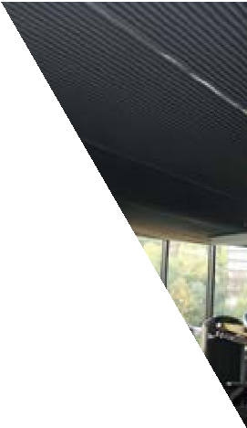
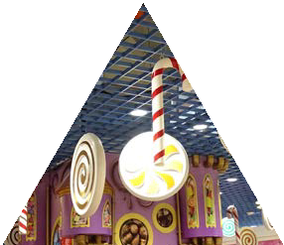
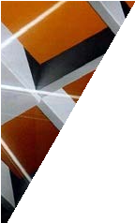

SUSPENDED
CEILINGS
REFINED DESIGN AND COMMUNICATON
NETWORKS
FIRE-RESISTANCE AND WATER PROOFNESS
GALVANIZED STEEL AND ALUMINIUM OPEN-CELL CEILINGS;
LINEAR CEILING OF LUXALON TYPE (85+15ММ; 85+5ММ);
LINEAR CAILINGS (FACADES)150ММ; 200ММ; 300ММ;
MULTI PANEL CEILINGS (130ММ; 80ММ; 30ММ; 20ММ);
METALLIC (PERFORATED) CEILING CASSETTE;
CURTAIN CEILINGS;
CUBE-SHAPED CEILINGS (PRISM-LINEAR DESIGN);
CEILING T-SHAPE CHANNEL Т24ММ, Т15ММ;
CEILING ADAPTORS;
DESIGNER NON-STANDARD CEILINGS.
CEILINGS BY MANUFACTURING FACTORY STELIPRO UKRAINE
SUSPENDED CEELINGS

Slide 2

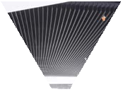
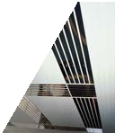
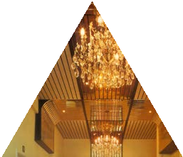
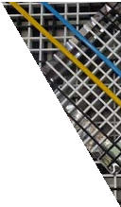
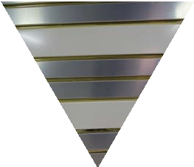
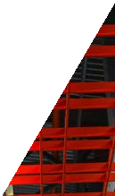
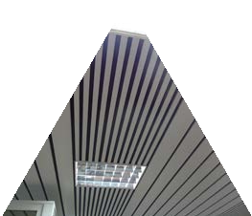
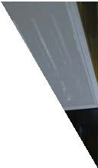
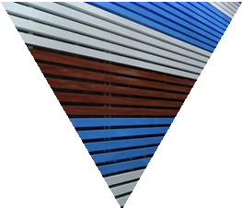
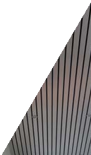
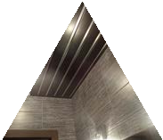
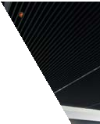
SUSPENDED CEELINGS
Our factory is the leader in the Ukrainian market, and is ready to offer our customers the widest range of suspended ceilings.
Apart of typical types of ceilings, we produce non-standard suspended ceilings, namely, a variety of sizes of open-cell ceilings, as well as individual designer ceilings.
Such ceilings can be installed in the premises of any configuration. Lately,multi-level ceilings with the use of different sizes and shape, structure, different colors and textures, as well as their unusual combination are on high demand. Our factory has a huge experience of manufacturing and installation of not standard design
ceilings that create exclusive composition with a unique charm. The specialists of our company will help you realize any idea on an individual, unique ceiling design.
Furthemore, the factory posesses its own polymer coating line. It allows you to offer customers ceilings with original color solution. For example, ceilings with wood imitation look very stylish and natural. For those, who want to visually expand the room, mirror-like suspended metal ceilings will be of their taste.
Our company has more than 25 years of experience in successful implementation of the most audacious and huge projects for the production and installation of designer suspended metal ceilings not only in Ukraine, but also abroad.
Unlimited and ever-growing opportunities of the Company for the production of suspended ceilings guarantee an individual approach to each customer.
By cooperating with our Company, you can get non- standard design suspended metal ceilings that are reliable, unique, environmentally friendly and very convenient in service.
Contact professionals!
3

Slide 3
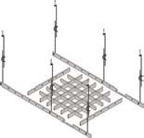
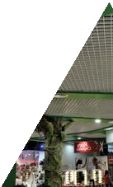
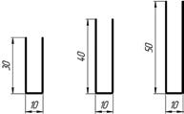
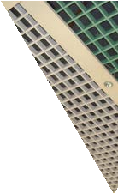
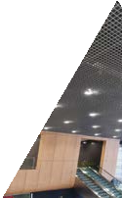
1. GALVANIZED STEEL AND ALUMINIUM
STELIPRO CEILINGS
STELIPRO ceilings are grids, assembled from U-shaped channels with 10 mm in width, 30, 40, 50 by
height installed in suspended OPEN- CELL grating or in grating from T15,
T24 channels (type 8).
THE SPECIFICATION OF SUSPENDED CEILING:
Delivery type: unassembled /assembled panels Material: aluminium, galvanized steel Thickness: 0,25 - 0,4 mm
U-shaped channel width: 10 mm
Н-shaped channel height: 30 mm / 40 mm/ 50 mm Cassette size: 600x600 mm
Cell size: 50х50 mm, 60х60 mm, 75х75 mm,
86х86 mm, 100х100 mm, 120х120 mm, 150х150 mm, 200х200 mm (or non-standard size)
Standard color: white / black /grey
Customized color: any RAL / mirror / gold / e.t.c. Coating: decoration as wood imitation
The weight of ceiling: from 1,4 to 6 kg/m2
1.1 CELL SIZE IN STANDARD STELIPRO CEILING
The amount of strips in the ceiling:
11 pc
50Х50 mm
9 pc
60Х60 mm
7 pc
75Х75 mm
6 pc
86Х86 mm
5 pc
100Х100 mm
4 pc
120Х120 mm
3 pc
2 pc
200Х200 mm
150Х150 mm
1.2 NON-STANDARD CELL SIZES
300Х50 mm 300Х60 mm 300Х75 mm
300Х86 mm
300Х100 mm
300Х120 mm
300Х150 mm
300Х200 mm
stelipro.com.ua

Slide 4
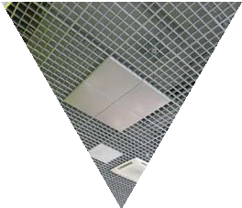
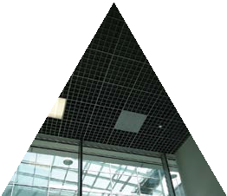
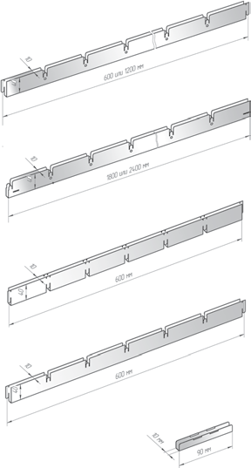
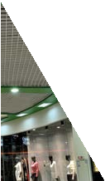
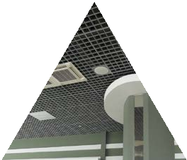
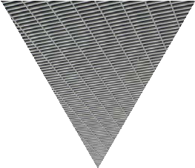
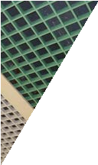
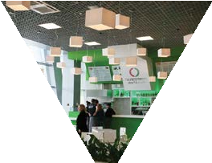
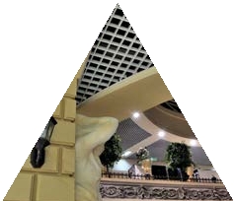
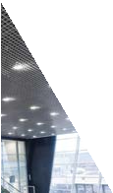
600Х50 mm 600Х60 mm 600Х75 mm 600Х86 mm 600Х100 mm 600Х120 mm 600Х150 mm 600Х200 mm
1200Х50 mm 1200Х60 mm 1200Х75 mm 1200Х86 mm 1200Х100 mm 1200Х120 mm 1200Х150 mm 1200Х200 mm
1.3. STELIPRO CEILING WITH T-SHAPED CHANNEL INCLUDES T-SHAPED CHANNEL AS GRATING, AND CEILING CASSETTE CONSISTS OF UPPER AND LOWER CHANNELS WITH 0,6 MM WIDTH.
1. . transverse bearing
2. lengthwise bearing
3. upper channel
4. lower channel
5. Grating channel connector
stelipro.com.ua

Slide 5
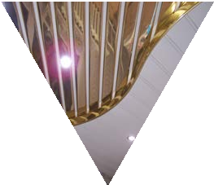
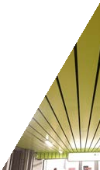
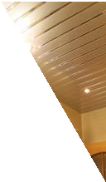
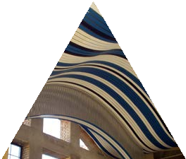
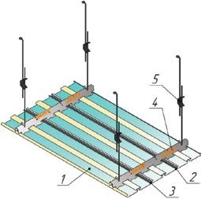

2. LINEAR CAILINGS
OF LUXALON
TYPE
(85+15 mm; 85+5 mm)
STELIPRO liner ceilings (straight and waive-shaped) are produced from aluminum and galvanizeed steel.
LINEAR CAILINDS SPECIFICATION:
Material: aluminum and galvanized steel.
Thickness: 0,3 - 0,5 mm Channel width: 15mm, 85 mm Variants of channel combination: 85+15 mm,
85+5 of isolation joint Channel length: any
Bending radius: R=300 mm, segment’s length - 670 mm Standard color: white / black /grey/gold/mirror Customized color: any RAL
Coating: decoration as wood imitation Ceiling weight: from 1,4 to 8 kg/м2
System composition:
1 – main channel 85 mm
2, 3 – cross channel 15 mm
4 – bearing channel (lengthwise beam)
5 – fastening elements (suspension)
Bearing channels (lengthwise beam): steel 0,5 mm / aluminum 0,95 mm
Standard length of bearing channel: up to 4 m Connection: by means of a connecting element, overlapped or butt-end
Channels combinations variants, mm:
85mm+15mm(isolation joint)=100 mm (moodule)
85mm+5mm(isolation joint)= 90 mm(module)
stelipro.com.ua

Slide 6










3. LINEAR SAILINGS
(FACADES)
(150 mm; 200 mm; 300 mm)
Aluminum and galvanized lath ceilings are very popular not only in public buildings and retail outlets, but also as facade framing of buildings.
LINEAR SAILINGS (FACADES) SPECIFICATION:
Material: aluminum and galvanized steel. Channel width: 0,4 - 0,8 mm
Channel length: any
Channel width: 150, 200, 300 mm Standard color: white / grey Customized color: any RAL Fastening variants:
horizontal /vertical/ diagonal
System composition:
– main channel / 200 / 300 mm
– bearing channel (lengthwise beam)
– П-shaped ending channel
Channels combination variants, mm:
1. 150 +150
2. 200+200
3. 300+300
.
0,6
16,5
150
17,2
stelipro.com.ua

Slide 7





4. MULTI-PANEL
CEILINGS
(130 mm; 80 mm; 30 mm; 20 mm)
The system of multi-panel liner ceilings consists of panels of 4 different types (20 mm, 30 mm, 80 mm, 130 mm
by width) of rectangular cross-section, all panels can be fastened to one universal bearing channel, which allows
combining different by width panels in any variation.
SPECIFICATION OF MULTI-PANEL LINER CEILING
Material: aluminum and galvanized steel; Thickness: 0,3 - 0,5 mm
Main channel width: 30 mm, 80 mm, 130 mm Insertion width: 20 mm
Channel length: any
Color: standard: white / black / grey / gold / mirror / ivory Customized color: any RAL
Coating: decoration as wood immitation Weight of a ceiling: from 1,4 to 8 kg/м2
Bearing channels (lengthwise beams): steel 0,5 mm / aluminum 0,95 mm Standard length of bearing channel: up to 4 m
Joint: abutment joint
System composition:
1, 2, 3, 4 – main channel 20 / 30 / 80 / 130 mm
- П-shaped ending channel
- bearing channel (lengthwise beam):
- fastening elements (suspension)
Channels combination variantes, mm
1. 130+20+80+20+30+20 | 3. 80+20+80+20 | 5. 80+20+30+20
2. 130+20+130+20 | 4. 30+20+30+20 | 6. Other combinations
stelipro.com.ua

Slide 8













Multi-panel liner ceilings is a modern system of liner ceilings, consisting of panels of different width, covered either with a matte texture or with a special mirror metalized composition.
Special features and composition of materials allow practical usage of multi-panel ceilings in a wide variety of buildings, while their capabilities and advantages allow the installation of framing. Such kind of ceilings especially popular in rooms with high humidity (swimming pools, saunas), in medical institutions, schools, shops, etc., as they tolerate humidity and temperature changes, while retaining the original appearance. Multi-panel lath ceilings are very practical, since various elements of ceiling systems can be easily installed in them (lighting units, security and fire alarm, air conditioning, ventilation
grilles, etc.)
Multi-panel liner ceiling is one of the most popular among architects and designers. If you combine ceiling panels of different widths, heights and colors on one ceiling - you can
always visually change the size of the ceiling and
create a unique design solution.
stelipro.com.ua

Slide 9






5. METALLIC (PERFORATED)
CEILING CASSETTES
Metallic cassette ceilings are made of steel or aluminum with the use of - with the use of decorative coatings: matte and glossy colors, polymer coating, mirror metal layer, etc
SPECIFICATON OF CASSETTE CEILING:
Material: aluminum / galvanized steel
Panel size: 300 х 300 mm, 600 х 600 mm, 600 х 1200 мм
Lay-in, Clip-in systems composition: visible tegular (Lay-¬in) / masked board (Clip-in)
Fastening type: visible suspension system Т24, Т15 Standard color: white / grey
Customized color: any RAL / mirror / gold / etc. Perforation: diameter 2, 3 mm
Acoustic layer: on order
Ceiling weight: от 6,2 до 8 кг/м2 Thickness: 0,3-1 мм thickness
System composition Lay-in, Clip-in
- Cassette
– Bearing channel 600, 1200, 3600
– Fastening unit
stelipro.com.ua

Slide 10





6. SCREEN CEILING
Suspended screen ceiling is a construction with lamellar panels that are attached to a special system by vertical strips parallel to each other. Due to the unique design, aluminum and zinc-coated lamellar ceilings look original and neat, and their design allows to pass uniform soft light and visually increases the height of the room. The choice of width and height of the panel allows you to mount a screen ceiling for narrow and small rooms.
SCREEN CEILING SPECIFICATION:
Material: aluminum / galvanized steel Thickness: 0,3-0,8 mm
Channel height: 85mm / 100 mm / 115mm Channel width: 13,4 mm
Pitch of rack: 50 mm / 100 mm / 150 mm / 200 mm Customized color: any RAL
Bearing channel: steel / aluminum Bearing channel length: any
Joint: abutment joint /any
Advantages of screen ceilings:
the screen ceiling visually increases the dimension of the room;
ideally hides all engineering communications, while retaining all their functions and efficiency; has a high level of sound absorption
due to the linear structure of the ceiling; perfectly combined with any type of ceiling;
It is possible to integrate any kind of ceiling light.
stelipro.com.ua

Slide 11




7. CUBE-SHAPED
CEILINGS
(PRISM-LINEAR DESIGN)
Cube-shaped ceilings (prism-linear design) are an innovation among modern design decorations. This version of the suspended ceiling is suitable for any kind of premises and will satisfy the most refined taste of customers.
APPLICATION SPHERE:
Material: galvanized steel and aluminum Thickness: 0,3-0,8 mm
Color: any by RAL-card Wood texture color Length: any
6
6
6 6
40
70
A wide range of implementation of this design is caused by the fact that the cube-shaped lath ceilings are made of aluminum or galvanized
steel, which are moisture resistant and fireproof. But full-measured creation of a large-scale beautiful ceiling with a three-dimensional effect is possible only in a large room with a decent squaring.
30, 35, 85
30, 35, 85
6
6
6
6
Therefore, it is possible to see with increasing frequency cube-shaped ceilings in the offices of large companies, shopping and entertainment centers, cinemas, clubs and restaurants. This type of ceiling is possible in any color solution, but the cube-shaped ceiling in the «natural wood» variant looks especially impressive.
85
100
30, 35, 85
30, 35, 85
stelipro.com.ua

Slide 12










8. T-SHAPED
CEILING CHANNEL
(Т24 mm, Т15 mm)
Suspended ceiling system is a unified solution for all types of suspended ceilings :
OPEN CELL ceilings
cassette metallic / aluminum
any of mineral fiber (gypsym)
SPECIFICATION OF Т-SHAPED SUSPENSION SYSTEM:
Material: galvanized steel Steel thickness: 0,3 mm
Т-shaped channel type: visible
The width of visible filling piece: 24 mm / 15 mm (Т24/ Т15) Channel height: 38 mm
Main channels: main guiding 3600 mm, lengthwise guiding 200 мм / 600 mm
Channels and additional elements: wall-adjacent L corner, stepped corner Z (W),
suspension (suspension-clamp, spoke)
Load carrying capacity
of Т-shaped system АМТТ is up to 78kgг/m2
stelipro.com.ua

Slide 13





9. CEILING ADAPTERS
Ceiling adapters are special devices, with the help of which you can easily solve the problem of compatibility of lighting units and STELIPRO ceiling systems. The use of ceiling adapters makes possible the graphical and constructive distribution of the weight of each lamp. The size of the adapter is selected individually for each ceiling and depends on the size of the open-cell ceiling cell .
Монтаж Installation of ceiling adapters is made in a system of suspended ceilings similar to ceiling panels.
Our factory offers you high-quality ceiling adapters.
for lighting units made of aluminum and galvanized steel.
We produce adapters of any size, color and diameter of the hole under the lamp.
A modern high-tech polymer painting line is installed on our factory. Thanks to this, we can make adapters in any
color, according to the RAL card.
And we can also make adapters with natural wood immitation, in colors of gold and a mirror.
The selection of the right high-quality adapter for ceiling systems is the key to obtaining the ideal final result - the reliable work of the ceiling system, the most convenient, safe and efficient.
stelipro.com.ua

Slide 14




10. DESIGNER NON-STANDARD
CEILINGS
Designer non-standard suspended ceilings are spectacular constructions, which are created using the most modern technologies and non-
standard interior solutions. Thanks to designer non-standard ceilings you can create unique composition with a unique charm in your room.
DESIGNER CEILING CHARACTERISTICS:
The effect of the uniqueness of designer suspended metal ceilings is easily achieved by combining different by size and shape constructions, original combinations and non-standard color solutions in ceiling planning scheme.
If you want to arrange the room in a classic design, our company can offer interesting and stylish kinds of suspended metal ceiling consisting of one level. And if you need a creative solution in the design of the ceiling space, then we are ready to offer exclusive multi-tiered constructions. Those who appreciate the naturalness and genuineness in the design of
the premises, should definitely pay attention to our suspended metal ceilings with wood imitation.
For fans of a spacious spacious room, we recommend to consider the option of suspended mirror metal ceilings. The «mirror» effect e will help visually expand the room. Reflections, glare adds originality, showiness and charm to any room. Our experts will help you realize any idea on an individual, unique ceiling design. It may be suspended metal ceilings, composed of elements of different sizes, be in the form of waves, geometric shapes, complex three-dimensional shapes, and more.
For more than 25 years, our company has been implementing the most ambitious and large- scale projects for the production and installation of designer suspended metal ceilings. By cooperating with us, you get design suspended metal ceilings, which are not only unique in their beauty, but also reliable, eco-friendly and easy to use.
stelipro.com.ua

Slide 15


The Antimonopoly Committee of Ukraine
Zhulyany Airport
stelipro.com.ua

Slide 16








Mandarin
Dynamo pool
stelipro.com.ua

Slide 17


Epicenter
Metrograd
stelipro.com.ua

Slide 18





«Dream Town» shopping and entertainment center
Sportlife
stelipro.com.ua

Slide 19




































SUSPENDED CEELINGS
08136, UKRAINE, KYIV (KYIV-SVYATOSHYN DISTRICT) KRYOKOVSHYNA, BALUKOVA STREET, 1 А
TEL.:+38 050 663 22 28
E-MAIL: SALES@STELIPRO.COM.UA
STELIPRO.COM.UA

