Slide 1
AH Redundant System
Ethan
PLCBU
MAR, 2018

Slide 2
Forms of Redundant System
Parallel Redundant System
Voting Redundant System
Double 2-vote-2 Redundancy (D2V2R)
Voter
Redundant
System
A₁
A₁
n/k
Voter
A₁
Main System
Redundant
System
A₂
A₂
A₂
Input
Main System
Output
Input
Output
Input
Output
A₃
A₃
…
…
B₁
Voter
Redundant System
Redundant
System
B₂
A_{n}
A_{n}
Rock Well：1756 L6X/L7X
Mitsubishi：Q12/Q25PRHCPU
Siemens：S7-400
Delta：AHCPU560-EN2
Schneider：M580
OMRON：CS1D
Functional Safety SIL3
Functional Safety SIL4
Notes:
冗余系統架構可以分成三種 並聯 表決 跟 複合型
並聯系統是由多組控制系統所組成 當主控制系統發生異常時 則會由冗余控制系統接替
今天所要介紹的 AH冗余主機 就是屬於這種類型
表決系統則是透過表決器 來決定輸出為何 表決器 則是透過硬體電路的設計 或是 程式邏輯的方式來實現
2乘2取2系統其實就是結合並聯與表決系統所構成

Slide 3
Types of Redundancy
Power Redundancy
CPU Redundancy
Communication Redundancy
Cable Redundancy
I/O Redundancy
AH500
Redundant
System
(Stage 1)
AH500 Redundant System
(Stage 2)
Notes:
AH冗余主機的冗余功能開發的分成兩個階段
第一階段包含了電源 主機 通訊與線路冗余 四種
在稍後會逐項跟大家進行介紹
而I/O冗余則會在第二階段進行開發

Slide 4
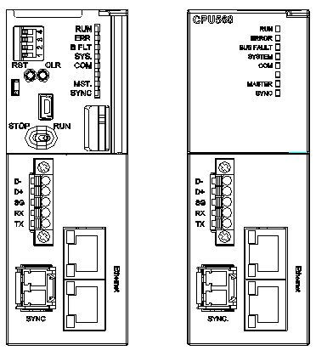
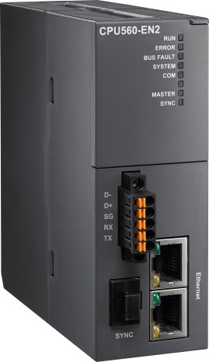

AH560-EN2 Introduction
AH560-EN2
AH560_EN CPU
SD Card Type
Micro SD (max 32GB)
Redundant Architecture
Redundant Backplane
Types of Redundancy
Specifications
Serial Communication Port
European-style terminal block
RS232/RS485
Redundant Configuration
AH Series Selection
System Switch
Fiber Optics Module
Data synchronization
Software Operation
Network COM Port
RJ45 x2
EtherNet/IP (DLR)
1. LCP-155A4HDRJ
2. LCP-155B4JDRJ
3. LCP-155B4MDRJ
Practice

Slide 5
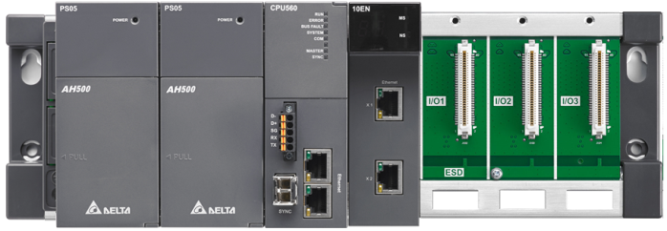
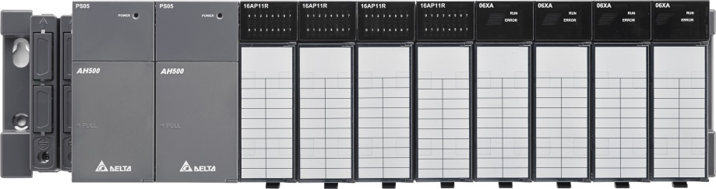
AH560-EN2 Introduction
AH560-EN2
AH560_EN CPU
Redundant Main Backplane：AHBP04MR1-5A
Redundant Architecture
Redundant Backplane
Power Redundancy
AHPS05-5A
AHPS15-5A
Types of Redundancy
Specifications
Redundant Configuration
AH Series Selection
Redundancy of Extension Backplanes ：AHBP06ER1-5A、AHBP08ER1-5A
System Switch
Software Operation
Practice

Slide 6
AH560-EN2 Introduction
AH560-EN2
AH560_EN CPU
Redundant Main Backplane：AHBP04MR1-5A
Redundant Architecture
Redundant Backplane
Communication Redundancy in Extension Backplanes
Types of Redundancy
Specifications
Redundant Configuration
AH Series Selection
Redundancy of Extension Backplanes ：AHBP06ER1-5A、AHBP08ER1-5A
System Switch
Software Operation
Practice

Slide 7
AH560-EN2 Introduction
Item | AHCPU560-EN2
Execution | The program is executed cyclically
I/O Control | Regenerated inputs/outputs Direct inputs/outputs
Programming language | IEC 61131-3
 | Ladder、FBD、IL、ST、SFC
Instruction execution speed | 12K Steps/ms
Number of Instructions | 666 instructions
Constant scan cycle (ms) | 1-32000 (The scan cycle can be increased by one millisecond)
Program capacity | 1M Steps
Installation | DIN rails or screws
Installation of a module | A module is installed directly on a backplane
Connection between two Backplanes | An extension cable connects two backplanes
Max. installed modules | 64 modules
Max. connected backplanes | 8 backplanes
Number of tasks | Single Mode: 283 tasks (32 cyclic tasks; 32 I/O interrupts; 4 timed interrupts; 2 communication interrupts; 1 external 24 V low-voltage; interrupt; 212 external interrupts) Redundant Mode: 36 tasks (32cyclic; tasks; 4 timed interrupts)
Numbers of I/O | Single Mode: 4352 points Redundant Mode: 3584 points
Input relays [X] | 65536（X0.0~X4095.15）
Output relays [Y] | 65536（Y0.0~Y4095.15）
Internal relays [M] | 8192（M0~M8191）
Link registers [L] | 262144（L0~262143）
Item | AHCPU560-EN2
Timers [T] | 2048（T0~T2047）
Counters [C] | 2048（C0~C2047）
32-bit counter [HC] | 64（HC0~HC63）
Data register [D] | 262144（D0~D262143）
Stepping relay [S] | 4096（S0~S4095）
Index register [E] | 32（E0~E31）
Special auxiliary relay[SM] | 4096 ( SM0~SM4095 )
Special data register [SR] | 4096 ( SR0~SR4095 )
Serial communication port | One RS-232/485
Ethernet Port | 10/100M
Modbus TCP Connections (Slave) | 32
Modbus TCP Connections (Master) | 128
EtherNet/IP CIP Connections | 256 (Slave+Master)
EtherNet/IP TCP Connections | 128 (Slave+Master)
USB Port | Mini USB
Storage interface | Micro SD
Remote RUN/STOP | The setting range is X0.0~X511.15
Real-time clock | Years, months, days, hours, minutes, seconds, and weeks
Switched Time | 20ms
Synchronous Speed | 0.5 ms/kbyte
AH560-EN2
AH560_EN CPU
Redundant Architecture
Redundant Backplane
Types of Redundancy
Specifications
Redundant Configuration
AH Series Selection
System Switch
Software Operation
Practice

Slide 8
AH560-EN2 Introduction
Backplane Lists |  | AH5x0 AH5x1 | AH560 (Single Mode) | AH560 (Redundant Mode)
Main Backplanes | AHBP04M1-5A | ○ | ○ | ○
 | AHBP06M1-5A | ○ | ○ | ○
 | AHBP08M1-5A | ○ | ○ | ○
 | AHBP12M1-5A | ○ | ○ | ○
Extension Backplanes | AHBP06E1-5A | ○ | ○ | ×
 | AHBP08E1-5A | ○ | ○ | ×
Redundant Main Backplane (*1) | AHBP04MRI-5A | ○ | ○ | ○
Redundancy of Extension Backplanes (*1) | AHBP06ERI-5A | ○ | ○ | ○
 | AHBP08ERI-5A | ○ | ○ | ○
*1：Power Redundancy *2：Extension Backplanes can’t work with Redundancy of Extension Backplanes at the same time
AH560-EN2
AH560_EN CPU
Redundant Architecture
Redundant Backplane
Types of Redundancy
Specifications
Redundant Configuration
AH Series Selection
System Switch
Software Operation
Practice

Slide 9

Redundant Architecture
AH560-EN2
AH Redundant System
Redundant Architecture
Extension Backplane
Master CPU
Standby CPU
Types of Redundancy
Circuit Redundancy
◆
Redundant Configuration
Network Redundancy
System Switch
. SYNC Cable (Fiber Optics)
Software Operation
Practice
9

Slide 10
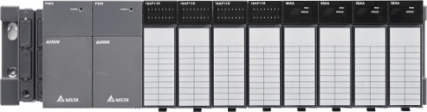
Redundant Architecture
AH560-EN2
AH Redundant System
Redundant Architecture
Extension Backplane
Master CPU
Standby CPU
Types of Redundancy
Circuit Redundancy
◆
Redundant Configuration
Network Redundancy
❖
System Switch
. SYNC Cable (Fiber Optics)
. Extension Cable for
connecting extension
backplane
Redundancy of Extension Backplane
Software Operation
Practice
Redundancy of Extension Backplane
10

Slide 11
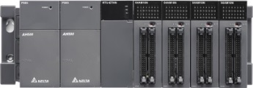
Redundant Architecture
AH560-EN2
AH Redundant System
Redundant Architecture
Extension Backplane
Master CPU
Standby CPU
Types of Redundancy
Circuit Redundancy
◆
Redundant Configuration
Network Redundancy
❖
⬥
System Switch
. SYNC Cable (Fiber Optics)
. Extension Cable for
connecting extension
backplane
. Ring Network ( DLR )
EtherNet/IP
Redundancy of Extension Backplane
RTU
Software Operation
Practice
Redundancy of Extension Backplane
RTU
11

Slide 12
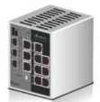

Redundant Architecture
AH560-EN2
AH Redundant System
Workstation
Ring Redundancy
Redundant Architecture
Extension Backplane

Master CPU
Standby CPU
Types of Redundancy
Circuit Redundancy
◆
Redundant Configuration
Network Redundancy
❖
⬥
System Switch
. SYNC Cable (Fiber Optics)
. Extension Cable for
connecting extension
backplane
. Ring Network ( DLR )
EtherNet/IP
. Star Network
EtherNet/IP
Modbus TCP
Redundancy of Extension Backplane
RTU
Software Operation
Practice
Redundancy of Extension Backplane
RTU
12

Slide 13
Types of Redundancy
AH560-EN2
Power Redundancy
Workstation
Ring Redundancy
Redundant Architecture
CPU Redundancy

Master CPU
Standby CPU
Types of Redundancy
Communication Redundancy in Extension Backplanes

◆
Redundant Configuration
Network Redundancy
❖
⬥
System Switch
. SYNC Cable (Fiber Optics)
. Extension Cable for
connecting extension
backplane
. Ring Network ( DLR )
EtherNet/IP
. Star Network
EtherNet/IP
Modbus TCP
Redundancy of Extension Backplane
RTU
Software Operation
Practice
Redundancy of Extension Backplane
RTU
13
Notes:
Power redundant (1)

Slide 14
Types of Redundancy
AH560-EN2
Power Redundancy
Workstation
Ring Redundancy
Redundant Architecture
CPU Redundancy

Master CPU
Standby CPU
Types of Redundancy
Communication Redundancy in Extension Backplanes
◆
Redundant Configuration
Network Redundancy
❖
⬥
System Switch
. SYNC Cable (Fiber Optics)
. Extension Cable for
connecting extension
backplane
. Ring Network ( DLR )
EtherNet/IP
. Star Network
EtherNet/IP
Modbus TCP
Redundancy of Extension Backplane
RTU
Software Operation
Practice
Redundancy of Extension Backplane
RTU
14
Notes:
CPU redundant (1)

Slide 15
Types of Redundancy
AH560-EN2
Power Redundancy
Workstation
Ring Redundancy
Redundant Architecture
CPU Redundancy


Standby CPU
Master CPU
Types of Redundancy
Communication Redundancy in Extension Backplanes

◆
Redundant Configuration
Network Redundancy
❖
⬥
System Switch
. SYNC Cable (Fiber Optics)
. Extension Cable for
connecting extension
backplane
. Ring Network ( DLR )
EtherNet/IP
. Star Network
EtherNet/IP
Modbus TCP
Redundancy of Extension Backplane
RTU
Software Operation
Practice
Redundancy of Extension Backplane
RTU
15
Notes:
CPU redundant (1)

Slide 16
Types of Redundancy
AH560-EN2
Power Redundancy
Workstation
Ring Redundancy
Redundant Architecture
CPU Redundancy

Master CPU
Standby CPU
Types of Redundancy
Communication Redundancy in Extension Backplanes
◆
Redundant Configuration
Network Redundancy
❖
⬥
System Switch
. SYNC Cable (Fiber Optics)
. Extension Cable for
connecting extension
backplane
. Ring Network ( DLR )
EtherNet/IP
. Star Network
EtherNet/IP
Modbus TCP

Redundancy of Extension Backplane
RTU
Software Operation
Practice
Redundancy of Extension Backplane
RTU
16
Notes:
CPU redundant (1)

Slide 17
Types of Redundancy
AH560-EN2
Power Redundancy
Workstation
Ring Redundancy
Redundant Architecture
CPU Redundancy

Master CPU
Standby CPU
Types of Redundancy
Communication Redundancy in Extension Backplanes
◆
Redundant Configuration
Network Redundancy
❖
⬥
System Switch
. SYNC Cable (Fiber Optics)
. Extension Cable for
connecting extension
backplane
. Ring Network ( DLR )
EtherNet/IP
. Star Network
EtherNet/IP
Modbus TCP
Redundancy of Extension Backplane
RTU

Software Operation
Practice
Redundancy of Extension Backplane
RTU
17
Notes:
CPU redundant (1)

Slide 18
Types of Redundancy
AH560-EN2
Power Redundancy
Workstation
Ring Redundancy
Redundant Architecture
CPU Redundancy


Standby CPU
Master CPU
Types of Redundancy
Communication Redundancy in Extension Backplanes
◆
Redundant Configuration
Network Redundancy
❖
⬥
System Switch
. SYNC Cable (Fiber Optics)
. Extension Cable for
connecting extension
backplane
. Ring Network ( DLR )
EtherNet/IP
. Star Network
EtherNet/IP
Modbus TCP
Redundancy of Extension Backplane
RTU
Software Operation
Practice
Redundancy of Extension Backplane
RTU
18
Notes:
CPU redundant (1)

Slide 19
Redundant Configuration
AH560-EN2
System Limitation
Selection of Extension Backplane：
AHBP06ER1-5A
AHBP08ER1-5A
Modules Selection for Main Backplane：
AH10SCM-5A v1.06 or later version
AH15SCM-5A v1.02 or later version
AH10EN-5A v2.04 or later version
AH15EN-5A
Modules Selection for Extension Backplane：
Digital I/O Module
Analog I/O Module
AH10SCM-5A (v1.06)
AH15SCM-5A (v1.02)
Tasks Limitation：
Cyclic tasks
Timed tasks
Supported Software Versions：
ISPSoft 3.04 or later version
DCISoft 1.19 or later version
EIP Builder 1.05 or later version
Redundant Architecture
Enable Redundancy
Types of Redundancy
Determine Conditions
Redundant Configuration
Check
System Switch
Data Synchronization
Software Operation
Synchronous Data Capacity
Practice

Slide 20
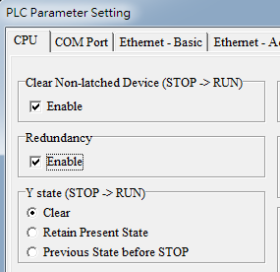
Redundant Configuration
AH560-EN2
System Limitation
ISPSoft -> HWCONFIG -> CPU -> System
Redundant Architecture
Enable Redundancy
Types of Redundancy
Determine Conditions
Redundant Configuration
Check
System Switch
Data Synchronization
Software Operation
Synchronous Data Capacity
Practice

Slide 21
Redundant Configuration
AH560-EN2
System Limitation
Master CPU
Standby CPU
Redundant Architecture
Enable Redundancy
SYNC Cable (Fiber Optics)
192.168.1.1
192.168.1.13
192.168.1.17
192.168.1.15
Types of Redundancy
Determine Conditions
192.168.1.2
192.168.1.14
Redundant Configuration
Check
Whether Enable Redundant Mode?
The order for powering on CPU→ Master CPU is the first one to power on
Whether CPU have projects?
Whether CPU have errors?
CPU MAC value→ Master CPU MAC value is the largest
System Switch
Data Synchronization
Software Operation
Synchronous Data Capacity
Practice

Slide 22
Redundant Configuration
AH560-EN2
System Limitation
Master CPU
Standby CPU
Redundant Architecture
Enable Redundancy
SYNC Cable (Fiber Optics)
Types of Redundancy
Determine Conditions
Unsynchronized
Synchronize
CPU FW versions must be compatible
Module selections must be the same
CPU and its according communication modules must at the same physical domain
✓
Redundant Configuration
Check
✓
System Switch
Data Synchronization
✓
Notice：Compatibility of FW version is according to sub-version value of digital in tens, like 1.0X.X compatible with 1.00.0
Software Operation
Synchronous Data Capacity
Practice

Slide 23
Redundant Configuration
AH560-EN2
System Limitation
Master CPU
Standby CPU
Redundant Architecture
Enable Redundancy
SYNC Cable (Fiber Optics)
Synchronize
Types of Redundancy
Determine Conditions
First time synchronization：
CPU Project
CPU Setting Value
Module Setting
Real-Time Clock
Cyclic Synchronization：
Changed Devices
Stop/Run LED status indicator
The parameters in the CPU modules
Synchronizing Time：
The end of scan
Synchronization points of tasks
Timed interrupt tasks
Redundant Configuration
Check
System Switch
Data Synchronization
Software Operation
Synchronous Data Capacity
Practice

Slide 24
Redundant Configuration
AH560-EN2
System Limitation
Master CPU
Standby CPU
Redundant Architecture
Enable Redundancy
SYNC Cable (Fiber Optics)
Types of Redundancy
Determine Conditions
Device Change：
D0、D1000
M0
Device Change：
D0、D1、D2、D1000
M0、M1、M2
Redundant Configuration
Check
System Switch
Data Synchronization
Every 512 words as one range
Synchronous Data Capacity：
=> 1536 Words
Synchronous Data Capacity：
=> 1536 Words
Software Operation
Synchronous Data Capacity
Practice

Slide 25
System Switch
AH560-EN2
Switching Conditions
Master CPU
Standby CPU
Redundant Architecture
Program Execution
SYNC Cable (Fiber Optics)
192.168.1.1
192.168.1.13
192.168.1.2
192.168.1.14
Types of Redundancy
Redundant Configuration
The scenarios to cause system switch：
Errors in AH CPU(including of errors in the modules)
Add or remove modules
Removal of connection cable from CPU or communication modules
Instruction of system switch
System Switch
Software Operation
Practice

Slide 26
System Switch
AH560-EN2
Switching Conditions
Standby CPU
Master CPU
Redundant Architecture
Program Execution
SYNC Cable (Fiber Optics)
192.168.1.1
192.168.1.13
192.168.1.2
192.168.1.14
Types of Redundancy
192.168.1.2
192.168.1.14
192.168.1.1
192.168.1.13
Redundant Configuration
The scenarios to cause system switch：
Errors in AH CPU(including of errors in the modules)
Add or remove modules
Removal of connection cable from CPU or communication modules
Instruction of system switch
System Switch
Software Operation
Practice

Slide 27
System Switch
AH560-EN2
Switching Conditions
Master CPU
Standby CPU
Redundant Architecture
Program Execution
SYNC Cable (Fiber Optics)
Types of Redundancy
Task executing orders
Task1
Redundant Configuration
Synchronizing Time：
Synchronization points of tasks
Timer interrupt tasks
The end of scan
Task2
Task1
System Switch
Task3
Task2
System Switch
Task4
Task3
Software Operation
Task5
Task4
END
Task5
Practice
END

Slide 28
System Switch
AH560-EN2
Switching Conditions
Master CPU
Standby CPU
Redundant Architecture
Program Execution
SYNC Cable (Fiber Optics)
Types of Redundancy
Task executing orders
Task1
Redundant Configuration
Synchronizing Time：
Synchronization points of tasks
Timer interrupt tasks
The end of scan
Synchronizing Time：
Synchronization points of tasks
Timer interrupt tasks
The end of scan
Task2
Task3
System Switch
Task4
System Switch
Task3
Software Operation
Task5
Task4
END
Practice
Task5
END

Slide 29
System Switch
AH560-EN2
Switching Conditions
Master CPU
Standby CPU
Redundant Architecture
Program Execution
SYNC Cable (Fiber Optics)
Types of Redundancy
Task executing orders
Task1
Redundant Configuration
Synchronizing Time：
Synchronization points of tasks
Timer interrupt tasks
The end of scan
Task2
Task3
System Switch
…
Timer
Task
Task3
System Switch
Task3
Software Operation
Task4
Task4
END
END
Practice

Slide 30
System Switch
AH560-EN2
Switching Conditions
Master CPU
Standby CPU
Redundant Architecture
Program Execution
SYNC Cable (Fiber Optics)
Types of Redundancy
Task executing orders
Task1
Redundant Configuration
Synchronizing Time：
Synchronization points of tasks
Timer interrupt tasks
The end of scan
Task2
Task3
System Switch
…
Timer
Task
Task3
Task3
…
Software Operation
Task4
Task3
System Switch
Practice
END
Task4
END

Slide 31


Software Operation
AH560-EN2
Redundant System API Instructions
SSO：System Switch
Redundant Architecture
System Error Log
Types of Redundancy
Redundant System Event Records
Redundant Configuration
Redundant System Info.
RCS：Redundant System Info
S Description
System Switch
RTU Setting
(EIP DLR)
0：CPU ID
1：Redundant System Status
2：Power Modules Status
3：Master/Standby CPU LED Status
Software Operation
Practice

Slide 32

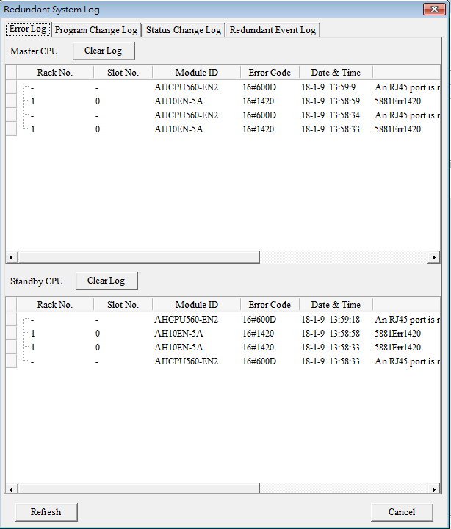

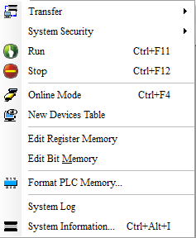
Software Operation
AH560-EN2
Redundant System API Instructions
Redundant Architecture
System Error Log
Types of Redundancy
Redundant System Event Records
Redundant Configuration
Redundant System Info.
System Switch
RTU Setting
(EIP DLR)
Software Operation
Practice

Slide 33
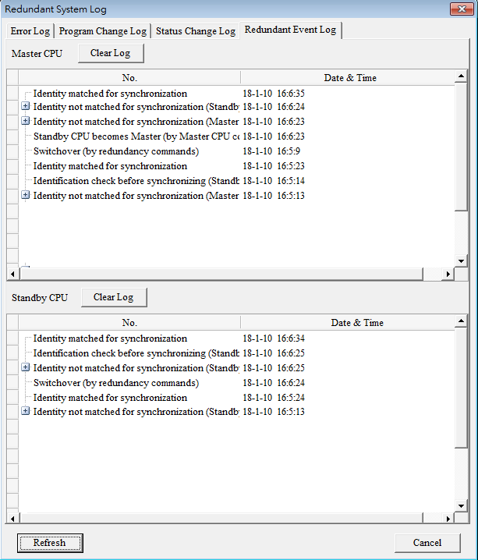
Software Operation
AH560-EN2
Redundant System API Instructions
Redundant Architecture
System Error Log
Types of Redundancy
Redundant System Event Records
Redundant Configuration
Redundant System Info.
System Switch
RTU Setting
(EIP DLR)
Software Operation
Practice

Slide 34
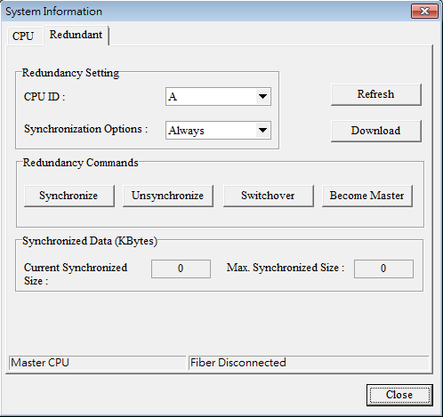

Software Operation
AH560-EN2
Redundant System API Instructions
Redundant Architecture
System Error Log
Types of Redundancy
Redundant System Event Records
Redundant Configuration
Redundant System Info.
System Switch
RTU Setting
(EIP DLR)
Software Operation
Practice

Slide 35

Software Operation
AH560-EN2
Redundant System API Instructions
Redundant Architecture
System Error Log
Types of Redundancy
Redundant System Event Records
Master CPU
Standby CPU
Redundant Configuration
Redundant System Info.
SYNC Cable
(Fiber-Optics)
CPU ID ：A
CPU ID ：B
System Switch
RTU Setting
(EIP DLR)
Change Master CPU to B
Change Standby CPU to A by itself
Software Operation
CPU ID：B
CPU ID ：A
Practice

Slide 36
Software Operation
AH560-EN2
Redundant System API Instructions
Redundant Architecture
System Error Log
Types of Redundancy
Redundant System Event Records
Setting of Synchronous | Allow Communication | Initiate Qualification check | Qualification check | Synchronous Data | Cyclic Check
Always | 1. Master CPU | Automatic | 1. Controller FW version 2. Main backplane module configurations 3. Same network | 1. Controller projects 2. Controller module configurations 3. Controller device values | 1. Any serious errors in the system 2. Bus fault 3. Same physical domain 4. Standby CPUs exist or not
Conditions | 1. Master CPU 2. Standby CPU | Manual | 1. Controller FW versions | 1. Controller device values | 1. Any serious errors in the system 2. Standby CPUs exist or not
Redundant Configuration
Redundant System Info.
System Switch
RTU Setting
(EIP DLR)
Software Operation
Practice

Slide 37

Software Operation
AH560-EN2
Redundant System API Instructions
Redundant Architecture
System Error Log
Types of Redundancy
Redundant System Event Records
Master CPU
Standby CPU
Redundant Configuration
Redundant System Info.
SYNC Cable
(Fiber-Optics)
System Switch
RTU Setting
(EIP DLR)
Unsynchronized
Synchronize
Software Operation
Practice

Slide 38
Software Operation
AH560-EN2
Redundant System API Instructions
Redundant Architecture
System Error Log
Types of Redundancy
Redundant System Event Records
Master CPU
Standby CPU
Redundant Configuration
Redundant System Info.
SYNC Cable
(Fiber-Optics)
System Switch
RTU Setting
(EIP DLR)
Synchronize
Unsynchronized
Software Operation
Practice

Slide 39
Software Operation
AH560-EN2
Redundant System API Instructions
Redundant Architecture
System Error Log
Types of Redundancy
Redundant System Event Records
Master CPU
Standby CPU
Redundant Configuration
Redundant System Info.
SYNC Cable
(Fiber-Optics)
System Switch
RTU Setting
(EIP DLR)
Synchronize
Software Operation
Practice

Slide 40
Software Operation
AH560-EN2
Redundant System API Instructions
Redundant Architecture
System Error Log
Types of Redundancy
Redundant System Event Records
Master CPU
Standby CPU
Redundant Configuration
Redundant System Info.
SYNC Cable
(Fiber-Optics)
System Switch
RTU Setting
(EIP DLR)
The functional button only works without Master CPU existing
Software Operation
Practice

Slide 41
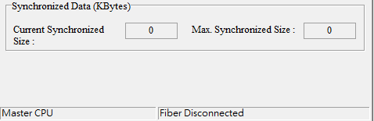
Software Operation
AH560-EN2
Redundant System API Instructions
Redundant Architecture
System Error Log
Types of Redundancy
Redundant System Event Records
Redundant Configuration
Redundant System Info.
Current synchronous data capacity：
SR24~SR25
The largest of historic synchronous data capacity：
SR26~SR27
Currently connected controllers：
Master CPU
Standby CPU
Current system status：
Redundant system is checking
Redundant system is ready
Single Mode
Failure of redundant system
SYNC cable is not connected
System Switch
RTU Setting
(EIP DLR)
Software Operation
Practice

Slide 42
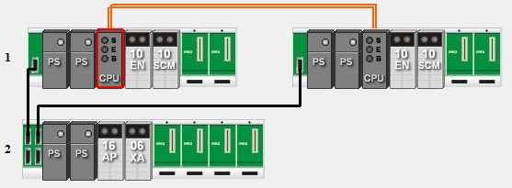
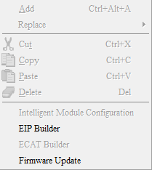
Software Operation
AH560-EN2
Redundant System API Instructions
1. Click EIP Builder
Redundant Architecture
System Error Log
Types of Redundancy
Redundant System Event Records
Redundant Configuration
Redundant System Info.
System Switch
RTU Setting
(EIP DLR)
Software Operation
Practice

Slide 43
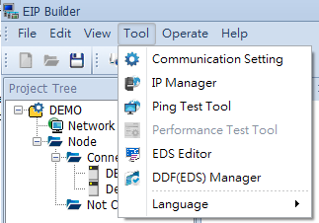
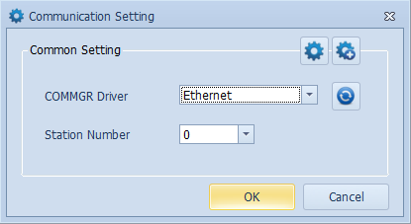
Software Operation
AH560-EN2
Redundant System API Instructions
2. Communication Setting
Redundant Architecture
System Error Log
Types of Redundancy
Redundant System Event Records
Redundant Configuration
Redundant System Info.
System Switch
RTU Setting
(EIP DLR)
Software Operation
Practice

Slide 44
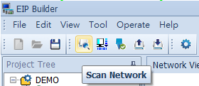
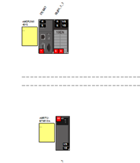
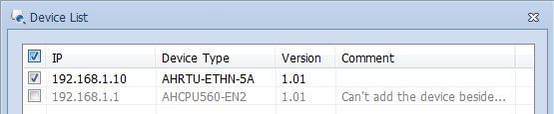
Software Operation
AH560-EN2
Redundant System API Instructions
3. Scan Network
Redundant Architecture
System Error Log
Types of Redundancy
Redundant System Event Records
Redundant Configuration
Redundant System Info.
System Switch
RTU Setting
(EIP DLR)
Software Operation
Practice

Slide 45
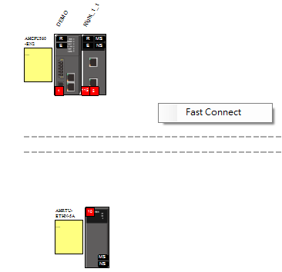
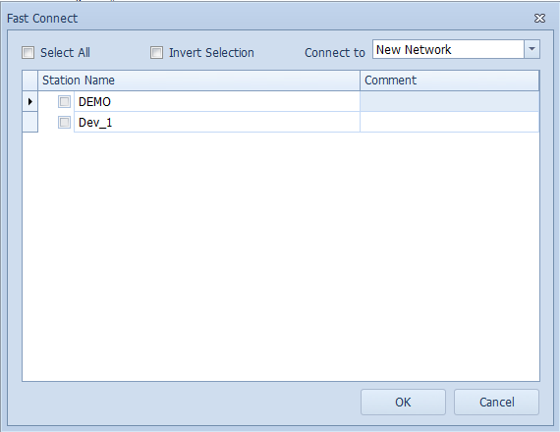
Software Operation
AH560-EN2
Redundant System API Instructions
4. Click the right button for Fast Connect
Redundant Architecture
System Error Log
Types of Redundancy
Redundant System Event Records
Redundant Configuration
Redundant System Info.
System Switch
RTU Setting
(EIP DLR)
Software Operation
Practice

Slide 46
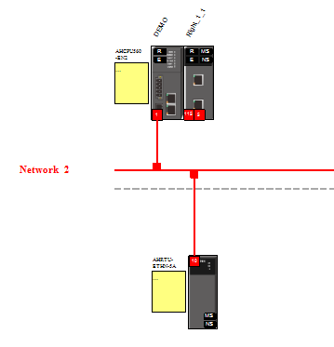
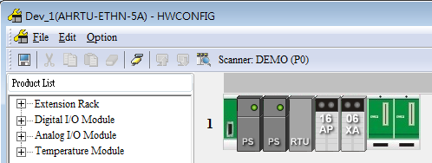


Software Operation
AH560-EN2
Redundant System API Instructions
5. RTU Module Setup
Redundant Architecture
System Error Log
Types of Redundancy
Redundant System Event Records
Redundant Configuration
Redundant System Info.
System Switch
RTU Setting
(EIP DLR)
Software Operation
Practice

Slide 47

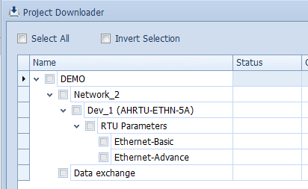
Software Operation
AH560-EN2
Redundant System API Instructions
6. Downloader
Redundant Architecture
System Error Log
Types of Redundancy
Redundant System Event Records
Redundant Configuration
Redundant System Info.
System Switch
RTU Setting
(EIP DLR)
RTU parameters
PLC data exchange table
Software Operation
Practice

Slide 48

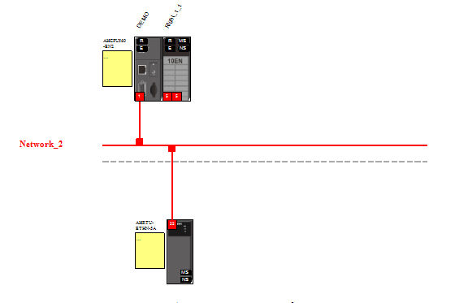
Software Operation
AH560-EN2
Redundant System API Instructions
7. On-line Mode
Redundant Architecture
System Error Log
Types of Redundancy
Redundant System Event Records
Redundant Configuration
Redundant System Info.
System Switch
RTU Setting
(EIP DLR)
Software Operation
Practice

Slide 49
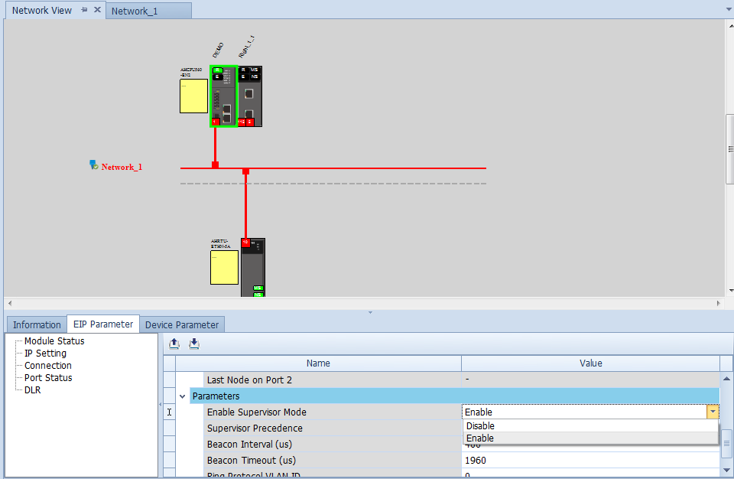
Software Operation
AH560-EN2
Redundant System API Instructions
8. Enable DLR
Redundant Architecture
System Error Log
Types of Redundancy
Redundant System Event Records
Redundant Configuration
Redundant System Info.
System Switch
RTU Setting
(EIP DLR)
Software Operation
5
3
Practice
4

Slide 50
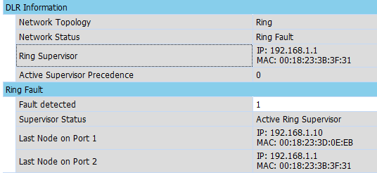
Software Operation
AH560-EN2
Redundant System API Instructions
9. Error Detection
Redundant Architecture
System Error Log
Types of Redundancy
Redundant System Event Records
Redundant Configuration
Redundant System Info.
System Switch
RTU Setting
(EIP DLR)
Software Operation
Practice

Slide 51
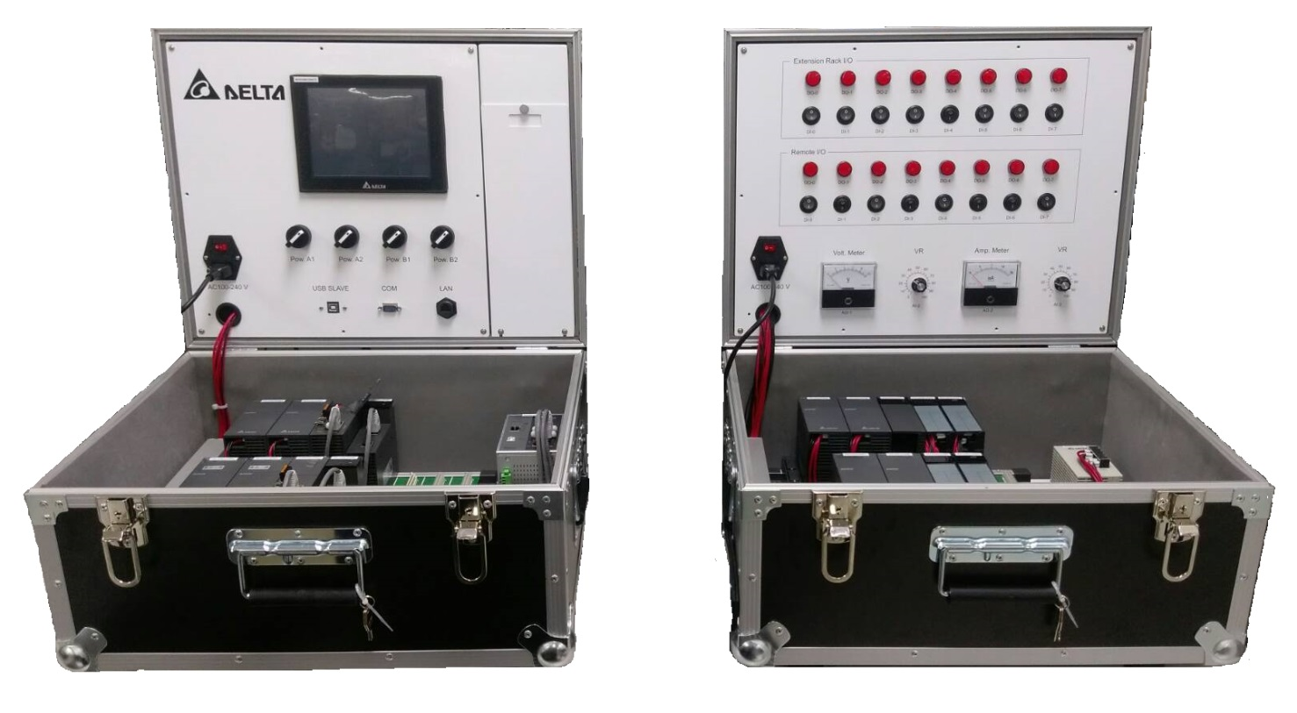
Practice
AH560-EN2
Starting Kits
Redundant Architecture
Types of Redundancy
Redundant Configuration
System Switch
Software Operation
Practice

Slide 52
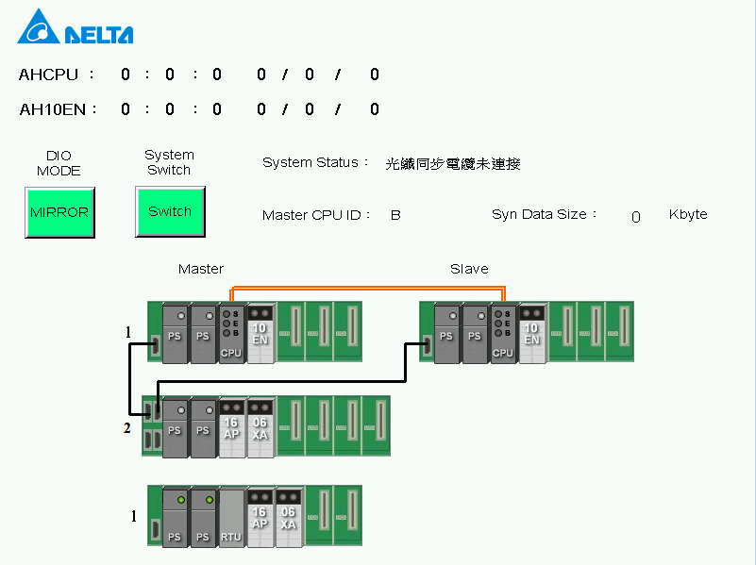
Practice
AH560-EN2
Starting Kits
System Switch
Redundant Architecture
Types of Redundancy
Redundant Configuration
System Switch
Software Operation
Practice

Slide 53
Practice
AH560-EN2
Starting Kits
Power Switch
Redundant Architecture
Types of Redundancy
Redundant Configuration
System Switch
Software Operation
Practice

Slide 54
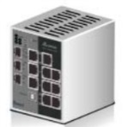

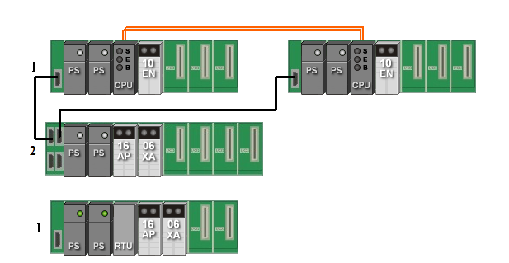
Practice
AH560-EN2
Starting Kits
Ring Network
Redundant Architecture
Switch
HMI
Types of Redundancy
Master CPU
Standby CPU
Start Network
Redundant Configuration
System Switch
Software Operation
RTU
Ring Network
EtherNet/IP DLR
Practice

Slide 55
Practice
AH560-EN2
Starting Kits
Start Network
Redundant Architecture
Switch
HMI
Types of Redundancy
Master CPU
Standby CPU
Start Network
Redundant Configuration
System Switch
Software Operation
RTU
Ring Network
EtherNet/IP DLR
Practice

Slide 56
Q&A

