Slide 1
AH-500 series
Redundant System
IABG - PLCBU

Slide 2
AH Redundant System
(AH Redundant CPU)

Slide 3
AH Redundant System
AH Redundant CPU
  AHCPU560-EN2
AH Redundant backplane
  AHBP04MR1-5A
  AHBP06ER1-5A
  AHBP08ER1-5A
  AH CPU and backplane compatibility
  AH Redundant function introduction
  Power redundant
  CPU redundant
  Network redundant
  Cable redundant

Slide 4
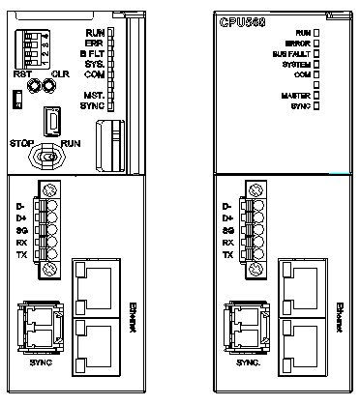
AHCPU560-EN2
SD Card type
Micro SD
Serial communication
European style terminal
RS232/RS485
Ethernet
2 * RJ45
EtherNet/IP (DLR)
Fiber module
Data sync

Slide 5
AH Redundant System
(AH Redundant backplane)

Slide 6
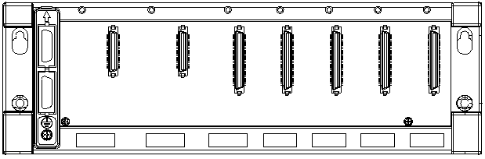
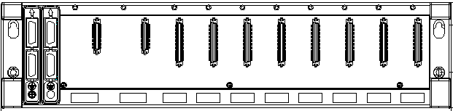
Redundant Backplane
Main redundant backplane：AHBP04MR1-5A
Extension redundant backplane：AHBP06ER1-5A、AHBP08ER1-5A
Power Redundant
AHPS05-5A
AHPS15-5A

Slide 7
Redundant Backplane
Main redundant backplane ：AHBP04MR1-5A
Extension redundant backplane ：AHBP06ER1-5A、AHBP08ER1-5A
Cable Redundant

Slide 8
AH Redundant System
(AH CPU and backplane compatibility)

Slide 9
CPU and Backplane Compatibility
Backplane list |  | AHCPU5x0 | AHCPU5x1 | AHCPU560-EN2 (single mode) | AHCPU560-EN2 (Redundant mode)
Main backplane | AHBP04M1-5A | ○ | ○ | ○ | ○
 | AHBP06M1-5A | ○ | ○ | ○ | ○
 | AHBP08M1-5A | ○ | ○ | ○ | ○
 | AHBP12M1-5A | ○ | ○ | ○ | ○
Extension backplane | AHBP06E1-5A | ○ | ○ | ○ | ×
 | AHBP08E1-5A | ○ | ○ | ○ | ×
Main redundant backplane (*1) | AHBP04MRI-5A | ○ | ○ | ○ | ○
Extension redundant backplane (*1) | AHBP06ERI-5A | ○ | ○ | ○ | ○
 | AHBP08ERI-5A | ○ | ○ | ○ | ○
*1：Power redundant support

Slide 10
AH Redundant System
(AH Redundant function introduction)

Slide 11

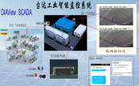



AH Redundant System
DVS
Ext. backplane
Fiber
Ring topology
Star topology
11

Slide 12
AH Redundant System
Modbus TCP
EtherNet /IP
DVS
Ext. backplane
Fiber
Ring topology
Star topology
12

Slide 13
AH Redundant System
EtherNet /IP (DLR)
DVS
Ext. backplane
Fiber
Ring topology
Star topology
13

Slide 14
Power Redundant
X
DVS
Ext. backplane
Fiber
Ring topology
Star topology
14

Slide 15
CPU Redundant
Main CPU
X
DVS
Ext. backplane
Fiber
Main CPU
Ring topology
Star topology

Slide 16
Cable Redundant
EtherNet /IP (DLR)
Main CPU
DVS
Ext. backplane
Fiber
X
Ring topology
Star topology
X

Slide 17
Network Redundant
Modbus TCP
EtherNet /IP
Main CPU
X
DVS
Ext. backplane
Fiber
Main CPU
Ring topology
Star topology

Slide 18
Smarter. Greener. Together.

